Slide 1
18LEM109T Indian traditional knowledge
Submission by:
Vighnesh Pradhan (RA2011030010180)
Harshit Sharma (RA2011030010206)
Sooraj Tomar (RA2011030010224)

Slide 2
Ancient Indian Water management and irrigation methods

Slide 3
Introduction
Water is the driving force for all civilizations
History depicts Mohenjo-daro and Harrapan civilizations were well aware of the importance of water (used for irrigation, domestic use and public baths)
Indian culture portrays water as pure and divine and hence offered to gods
From ancient through medieval era to modern period water (particularly oceans) is considered as a god
“Varuna”(in India) and “Osiris”(in Egypt)
Droughts and floods were also common during the ancient periods (Puri, 1968)
To combat these disasters, throughout the country different kingdoms had their own water harvesting techniques

Slide 4
Introduction
Archeological expeditions discovered Indus Valley civilization had excellent water harvesting and drainage systems
Dholavira, a major city of its age (currently in Gujrat) constructed sixteen reservoirs and used for
domestic use and irrigation
Three underground tanks and water was circulated by small channels to moderate the temperature
Chola King Karikalan constructed the Grand Anicut (check dam) or Kallanai across the river Cauvery to
divert water for irrigation (still operational)
King Bhoja of Bhopal built the largest artificial lake in IndiA

Slide 5
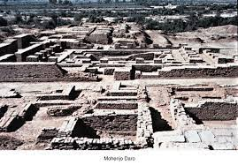
Ancient india
Comprised of Pakistan, India and Bangladesh
Mohenjo-daro: great bath (reservoir)
Conceived for agricultural purposes
Next slide: indus basin irrigation
system map

Slide 6
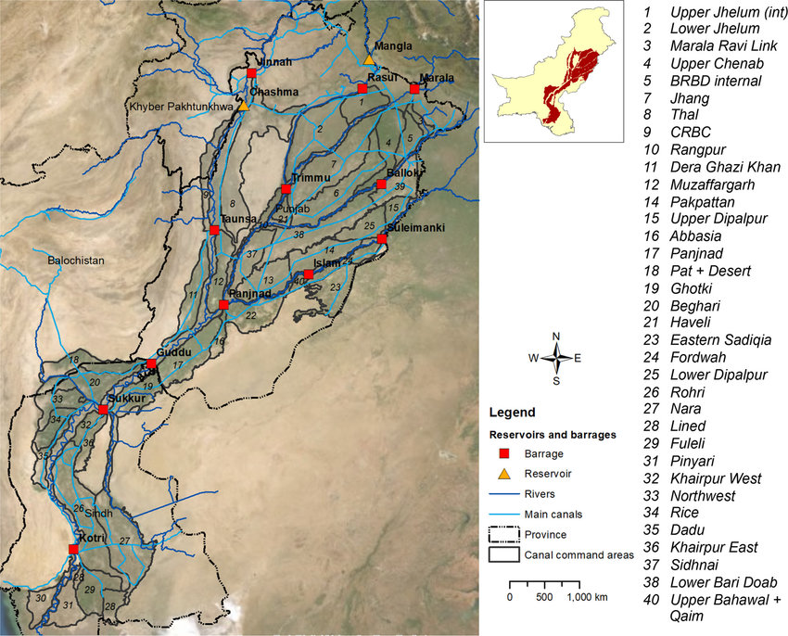

Slide 7
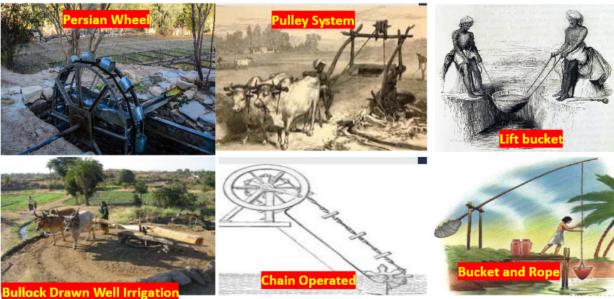
Ancient India irrigation methods (~2500BC)

Slide 8
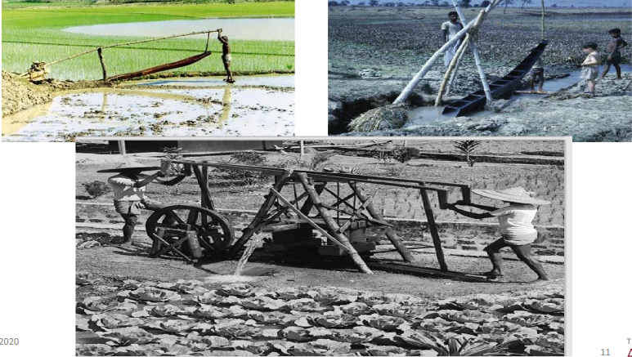
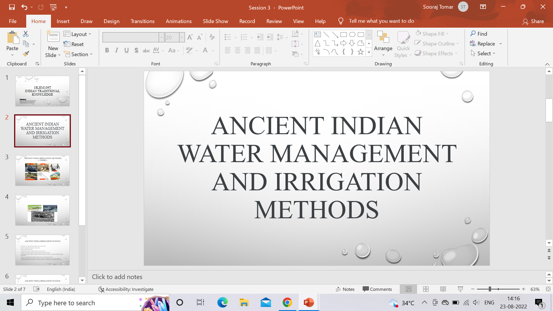
Ancient India irrigation methods (~2500BC)

Slide 9
Ancient India Irrigation system
Rigveda (~1500 BC) mentions irrigated agriculture
(kupa –artificial hollow in the earth)
(avata –artificial well)
Water was lifted by wheel (stone), strap and pail
Diverted to fields through surmi susira (broad channels)
First river water tapping for irrigation was around 500 BC as noted by Panini around Haridwar
Mauryan kingdom took pride in irrigation and earned revenue
Noria (waterwheel) was used to divert water into agricultural lands through channels First dam in India was constructed by Chandragupta Maurya (Puri, 1968

Slide 10
Ancient India Irrigation system
Vedas, ancient Indian writers and ancient Indian scriptures have references of wells, canals, tanks and dams
In Southern India, perennial agriculture became common with the construction of the Grand Anicut
dam. Additionally Cholan kingdom also introduced the tank irrigation system
Central and Western India were more reliable on irrigation water tanks for agricultural water needs
Northern India (Indus valley civilization) not only had water baths, but also great water diversion channels
Furthermore, Indus valley civilization also had artificial wells for water needs

Slide 11
Thank you

